Slide 1
Sprint 1 Status Update
Model for Calibration of Weather Data for Contrail Avoidance
Team SkySci Analytics
Week 1
05/29/2023

Slide 2



team Members
Matt Lomicka Scrum Master
Kevin Cheng Product Owner
Fraol Abebe Developer & GitHub Master
Radha Kanuri Developer

Slide 3
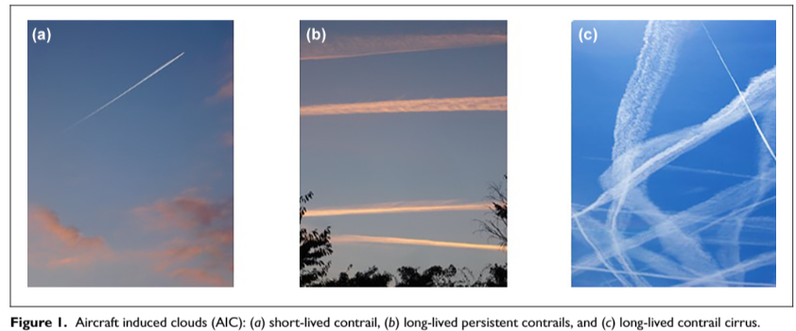
problem statement
Problem Context:
Domain of problem: Airline & Environment
Importance of problem: The world is inching towards an additional 1.5° Celsius or 2.7° Fahrenheit average increase in global temperature. Contrails is a leading producer of greenhouse gases for the airline industry; thus, preventing the creation of contrails is an immediate solution and can greatly help reduce global warming.
Problem Statements: Studies show that avoiding ISSRs by flying aircraft 2000 higher can potentially reduce the net radiative forcing from contrails by 67%. Accurately predicting and the avoidance of ISSR are significantly Important in mitigating the radiative forcing effects of contrails, however, the current measurement and forecasting methods are inaccurate and rely on limited aerosonde/weather balloon data. In this project, we aim to develop a Machine Learning model that can calibrate the current weather measurement/forecast data to improve the accuracy of ISSR and reduce the uncertainties associated with contrail formation.

Slide 4
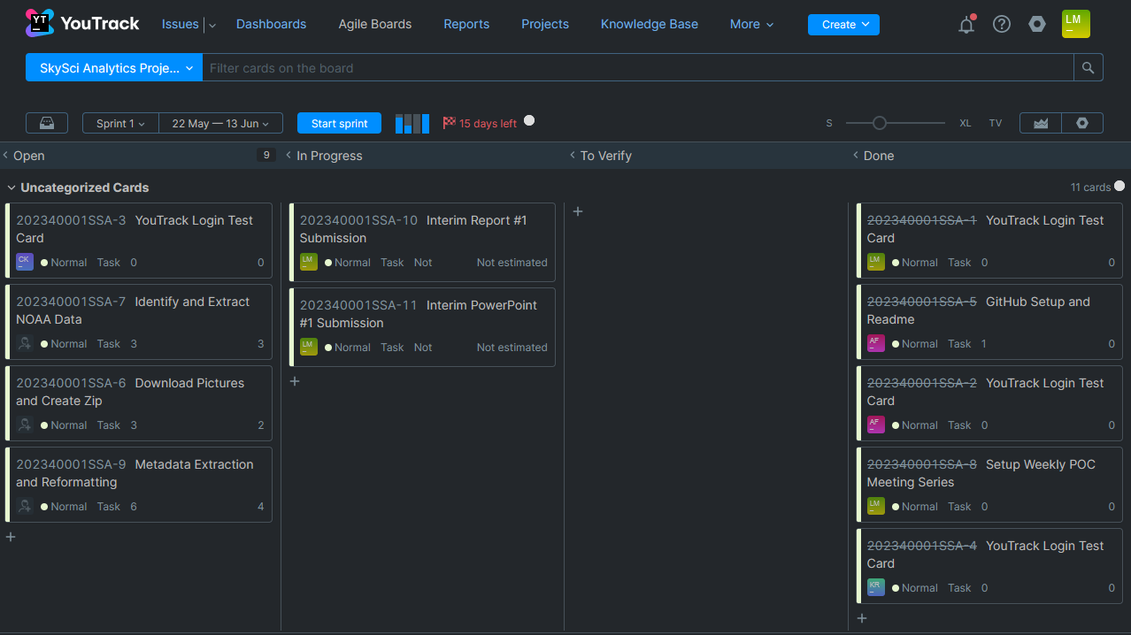
YouTrack- Overview
Instructions: SCRUM Master will bring up YouTrack Project page and show Sprint 1 Board
Work with instructor prior to mid-sprint-1 presentation to define all user stories and tasks
All user stories must have a description, exit criteria, assigned to team member, and priority
All user story associated tasks must a description, exit criteria, assigned to team member, and priority
SCRUM Master will be responsible for placing task in the “In Progress” column when ready;
Assigned team member to task is responsible for placing comments and attachment in the task; this will be reviewed by the team member assigned to verify the task and instructor; part of sprint grade
Assigned team member to task moves task to “To Verify” column with task is complete assigns team member to verify the task
Assigned team member to verify task will review the task and either move it to “Done” column if it satisfies exit criteria or moves it back to “In Progress” column with comments why if failed and reassigns to previous task assignee

Slide 5
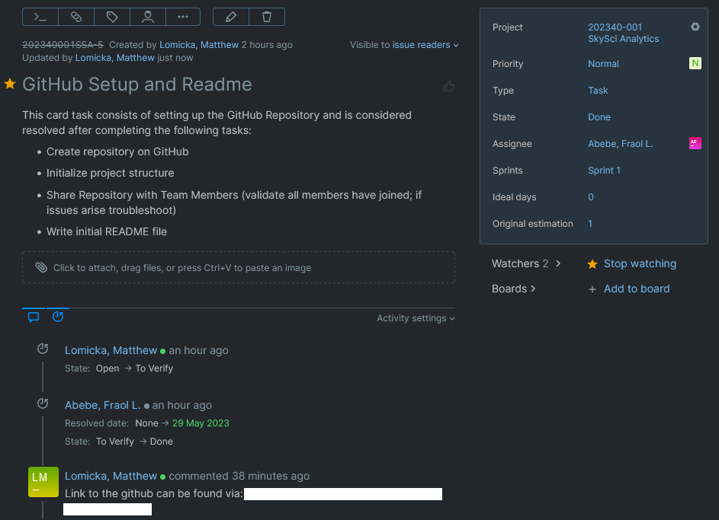
YouTrack – Example Card
Instructions: SCRUM Master will bring up YouTrack Project page and show Sprint 1 Board
Work with instructor prior to mid-sprint-1 presentation to define all user stories and tasks
All user stories must have a description, exit criteria, assigned to team member, and priority
All user story associated tasks must a description, exit criteria, assigned to team member, and priority
SCRUM Master will be responsible for placing task in the “In Progress” column when ready;
Assigned team member to task is responsible for placing comments and attachment in the task; this will be reviewed by the team member assigned to verify the task and instructor; part of sprint grade
Assigned team member to task moves task to “To Verify” column with task is complete assigns team member to verify the task
Assigned team member to verify task will review the task and either move it to “Done” column if it satisfies exit criteria or moves it back to “In Progress” column with comments why if failed and reassigns to previous task assignee

Slide 6
Datasets – Work in Progress
Proposed Datasets for Project
Dataset Name: Contrail Image Dataset
Dataset Owner: Lance Sherry and George Mason University
Dataset Type: Proprietary
Dataset Size: [e.g., 20 GB]
Dataset Name: Climate Dataset
Dataset Owner: National Oceanic and Atmospheric Administration (NOAA)
Dataset Type: Opensource
Dataset Size: [e.g., 20 GB]
Dataset Name: Contrail Dataset
Dataset Owner: Lance Sherry
Dataset Type: Proprietary
Dataset Size: [e.g., 20 GB]
Notes:
We will be filling these in as we learn more about our datasets once they are compiled.

Slide 7
Potential Analytics/algorithms – Algorithms
Our choice of algorithm depends on the specific problem, data characteristics, and available resources. We will experiment with different algorithms and evaluate their performance to select the most suitable one for our task.
Logistic Regression: A linear model that is widely used for binary classification tasks. It models the probability of the output belonging to a particular class.
Decision Trees: A tree-based model that splits data based on different features to create a hierarchy of decision rules. It is intuitive and can handle both categorical and numerical data.
Random Forest: An ensemble method that combines multiple decision trees to make predictions. It reduces overfitting and provides robust performance by aggregating predictions from individual trees.
Support Vector Machines (SVM): A powerful algorithm for binary classification tasks. SVM finds the optimal hyperplane that maximally separates the data points of different classes.
Naive Bayes: A probabilistic model based on Bayes' theorem and the assumption of feature independence. It is efficient and works well with high-dimensional data.
K-Nearest Neighbors (KNN): A simple algorithm that classifies new data points based on the majority class of their K nearest neighbors in the training set. It is non-parametric and doesn't require training.
Gradient Boosting Machines (GBM): An ensemble method that combines weak learners (typically decision trees) in a sequential manner. It optimizes the loss function by adding models that correct the mistakes made by previous models.
Neural Networks: Deep learning models consisting of interconnected layers of nodes (neurons) that learn complex patterns and relationships in the data. They are highly flexible and can handle large and diverse datasets.
AdaBoost: An ensemble method that combines multiple weak learners and assigns higher weights to misclassified instances. It adapts to the previous classifier's performance and improves overall accuracy.
XGBoost: A highly optimized implementation of gradient boosting that provides high performance and scalability. It has become popular in various machine learning competitions.
CatBoost: Another gradient boosting algorithm that handles categorical variables efficiently and provides strong out-of-the-box performance. It automatically handles feature preprocessing and offers GPU support.
Linear Discriminant Analysis (LDA): A dimensionality reduction technique that maximizes the separability between classes by projecting the data onto a lower-dimensional space.

Slide 8
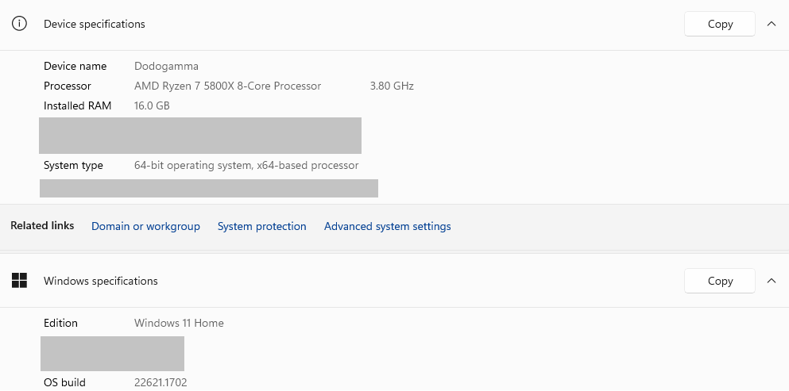
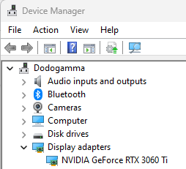
Potential Analytics/algorithms – Computer Resources (Matt’s Local Machine)

Slide 9

Weekly Partner Meeting Progress Update
Prior Week : N/A
Sprint #1 Interim #1:
Identify team name and roles
Read over material and ask clarification follow-up questions
Created GitHub repository and Slack communication channel
Established weekly meeting schedule with Project Partner
Create Tasks for Interim #2
Sprint #1 Interim #2:
Identifying and reassessing total project workload
Head-start on obtaining data to conduct data feasibility assessment
“Identifying a conversion from altitude in provided atmospheric units into feet” POC assigned task

Slide 10
Project Schedule (Work In Progress)
Task | Start Date | Estimated Completion Date | Duration | Actual Completion Date
Identify and Extract NOAA Data | 5/30/2023 | 6/3/2023 | 4
Download Pictures and Create Zip | 5/30/2023 | 6/5/2023 | 6
Metadata Extraction and Reformatting | 6/5/2023 | 6/9/2023 | 4
POC Meeting Friday | 6/2/2023 | 6/2/2023 | 0
We plan to closely model our Kanban board with a Gantt friendly format for excel. After more tasks are solidified this week, we plan to provide this chart format as well as a Gantt image format too. This synchronizes with parallel swim-lanes while providing the total tasks in one unified view.

Slide 11
Risks and Planned Mitigations
Risk Name | Description | Probability | Impact | Mitigation
Issues Downloading Google Drive photos | Possibility of encountering issues when downloading and zipping image data | Low | High | Create script to automate a replicated manual process or Manually Download each image
Inability to sync NOAA data and Image Metadata datetimes | Issues in identifying a shared datetime between NOAA data and image metadata datasets for like-like comparisons/validations | Medium | Low | Resolve to use different datetime metric such as grouped by morning, afternoon and evening hours.
Failure to Scrum | All members are new to the team; setting regular meeting time expectations and working around availability will continue to be navigated this week | Medium | High | Continue to use Slack and Email for communication; utilize teams conferencing for more direct and hands-on meeting instruction/direction

Slide 12
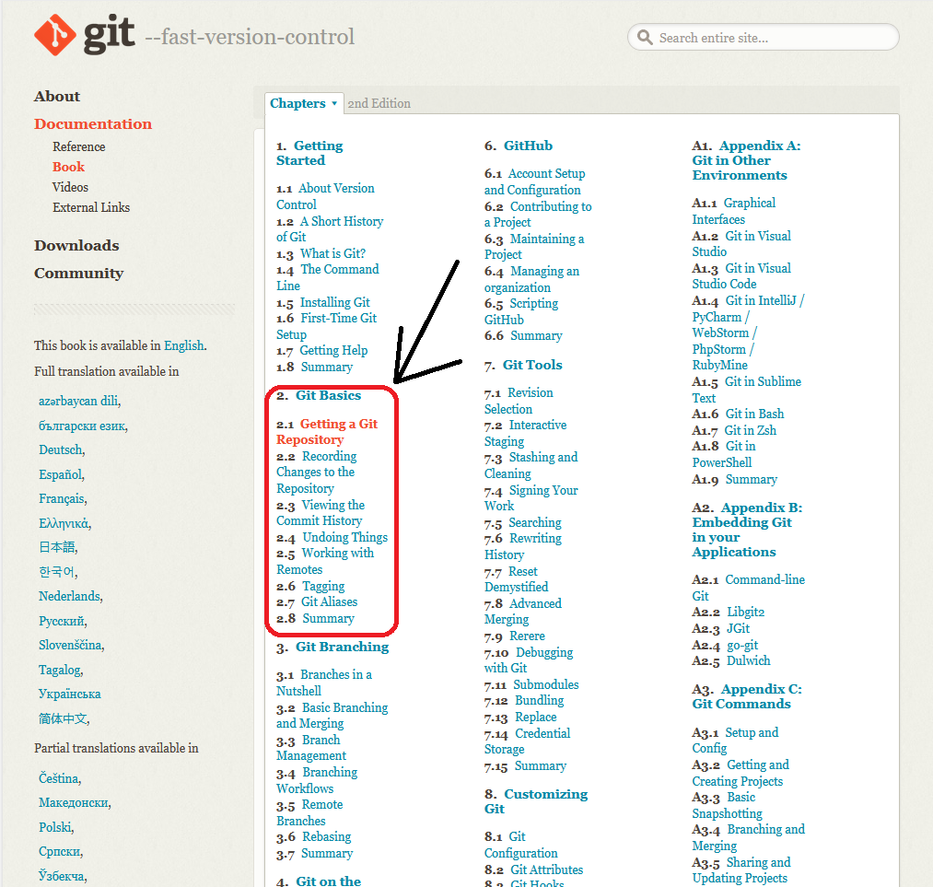
Helpful note For Both Groups
For new GIT users or as a refresher: https://git-scm.com/book/en/v2/Git-Basics-Getting-a-Git-Repository

Slide 13
References
Sherry, L., & Thompson, T. (2020). Primer on Aircraft Induced Clouds and Their Global Warming Mitigation Options. Transportation Research Record, 2674(11), 827–841. https://doi.org/10.1177/0361198120951188

